Slide 1
Predicting Dementia
Michael Kwan & Nahom Molla

Slide 2
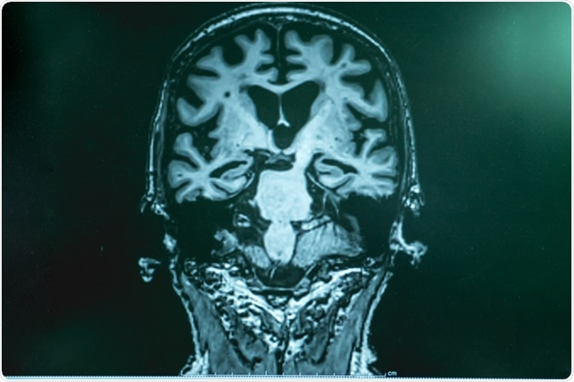
Introduction
Dataset: “OASIS-1: Cross-sectional MRI Data in Young, Middle Aged, Nondemented and Demented Older Adults”
416 subjects
All right handed.
Features
Gender(M/F)
Age
Education Level
Socioeconomic Status(SES)
Mini Mental State Examination(MMSE)
Estimated Total Intracranial Volume(eTIV)
Normalize Whole Brain Volume (nWBV)
Atlas Scaling Factor(ASF)
Target
Clinical Dementia Rating(CDR)

Slide 3
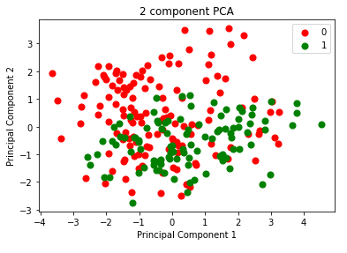
Unsupervised Models
Principal Component Analysis (PCA)
Component 1: [0.44711953, 0.15408128, 0.59221435, -0.27850459, -0.58996648]
-Explained 0.50365773 of the variance
Component 2: [0.19625851, -0.70454301, 0.16766767, 0.63916591, -0.16868977]
Explained 0.32848104 of the variance
K-Means Clustering
Center 1: [-0.61270642 -0.12926271 -0.5826881 0.2027143 0.57914777]
Center 2: [ 1.13642679 -0.01804274 0.9478226 -0.18305995 -0.93100618]
Accuracy: 0.661538
*['M/F', 'Age', 'eTIV', 'nWBV', 'ASF']
Figure 1. This figure shows the all the data visualized using the two components from PCA. The green represents positive for dementia and the red represents negative for dementia.

Slide 4
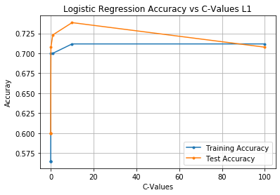
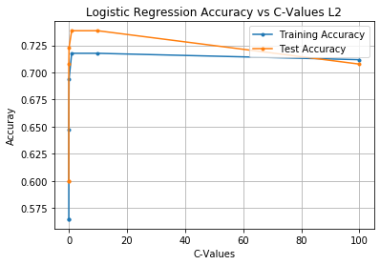
Supervised Models
Logistic Regression with Lasso Regularization
Testing Accuracy: 0.738
Logistic Regression with Ridge Regularization
Testing Accuracy: 0.738

Slide 5
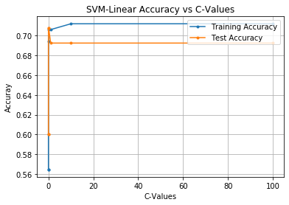
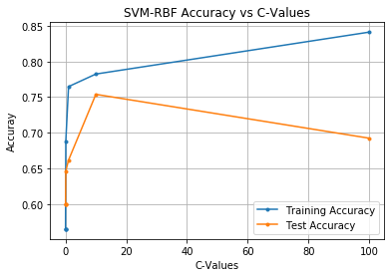
Supervised Models
Linear Kernel SVM
Testing Accuracy: 0.708
Radial Basis Kernel SVM
Testing Accuracy: 0.754

Slide 6
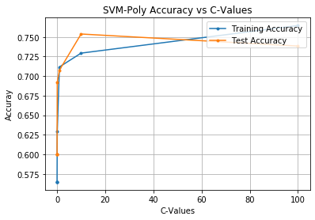
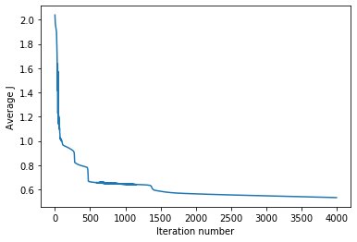
Supervised Models
Polynomial Kernel SVM
Testing Accuracy: 0.754
Neural Network
Testing Accuracy: 0.63

Slide 7
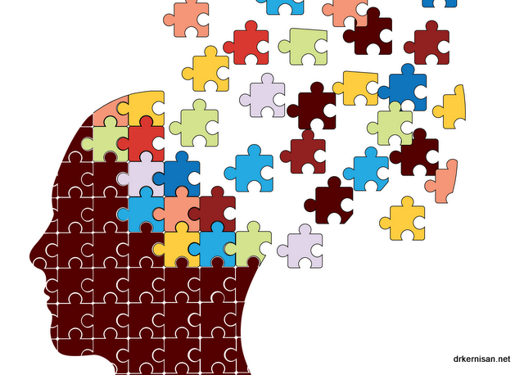
Conclusion
The most accurate models were the Radial Basis Kernel SVM and the Polynomial Basis Kernel SVM
Accuracy: 0.754
Future Work
Collect more data from more subjects and using more predictor variables
Test to see if handedness has an effect
Improve accuracy of models
Classify errors as false positives or false negatives in models
Dataset
https://www.kaggle.com/jboysen/mri-and-alzheimers

